Slide 1
NoSQL Databases Evaluation for Eiffel Event Data
Presentation of the evaluation’s results
Jakub Binieda (ebinjak)
Ericsson AB
2019-01-22

Slide 2
Structure of the presentation
Assignment description
Choose of Database Management System (DBMS)
DBMS and different implementations
Tests description
Results
Conclusion
Summary
Q&A

Slide 3
Assignment Description
Evaluate alternative NoSQL data models and DBMS that supports those models to find a better solution that could increase performance and could be used instead of MongoDB.

Slide 4
Choose of DBMS
Theory part of the investigation
Five NoSQL data models
Key-Value, Wide Column, Document, Graph and Mult-model
Different criteria
Eiffel events

Slide 5
MongoDB
DBMS that supports document model
Supports JSON
Capacity can be increased by adding new machines
Slow for connected models that require joins
High Availability and High Scalability
Versioning and Indexing

Slide 6
Neo4j
DBMS that supports graph model
Do not support JSON directly, you need to use apoc library or manipulate data into CSV format
High Availability (only enterprise version)
Supports cluster deployment
Indexing
Versioning (not native)
Good for connected data

Slide 7
ArangoDB
DBMS that supports key, document and graph models
Supports JSON
Indexing and Versioning
High Availability and High Scalability
Supports cluster deployment
Good documentation, but can be difficult to understand how some things works

Slide 8
Implementations
MongoDB
Neo4j
Implementation 1
Implementation 2
ArangoDB
Implementation 1
Implementation 2

Slide 9
Tests
Different amount of events: 10 000, 100 000, 1000 000
All test cases where executed 10 times (if possible)
Measured data:
For whole implementation of the function:
Average execution time, average execution time per found event
For communication with database:
Average execution time, average execution time per found event
Execution time is measured in microseconds
No indexing *

Slide 10
Store()
Average execution time
DBMS | 10 000 | 100 000 | 1000 000
MongoDB | 5.23+06 | 4.69+07 | 4.27+08
Neo4j Imp 1 | 4.72E+08 | 3.17E+10 | -
Neo4j Imp 2 | 9.97E+09 | - | -
ArangoDB Imp 1 | 4.05E+06 | 3.82E+07 | 3.49E+08
ArangoDB Imp 2 | 3.93E+07 | 3.89E+08 | 4.09E+09

Slide 11
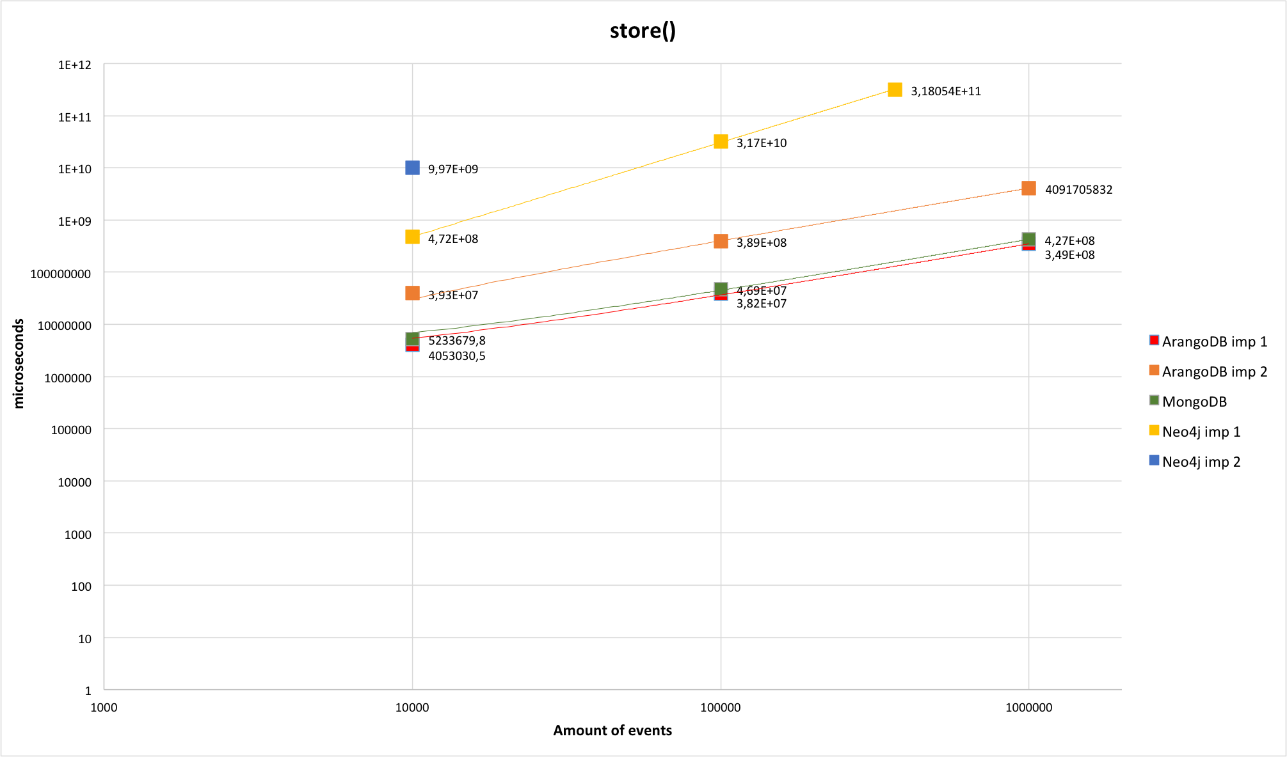

Slide 12
getEvent()
Average execution time
DBMS | 10 000 | 100 000 | 1000 000
MongoDB | 4170 | 4680.9 | 6247.1
Neo4j Imp 1 | 56830.7 | 309152.8 | -
Neo4j Imp 2 | 313173.7 | - | -
ArangoDB Imp 1 | 13408.1 | 84845.2 | 818298
ArangoDB Imp 2 | 13483.1 | 81983.8 | 811778.5

Slide 13
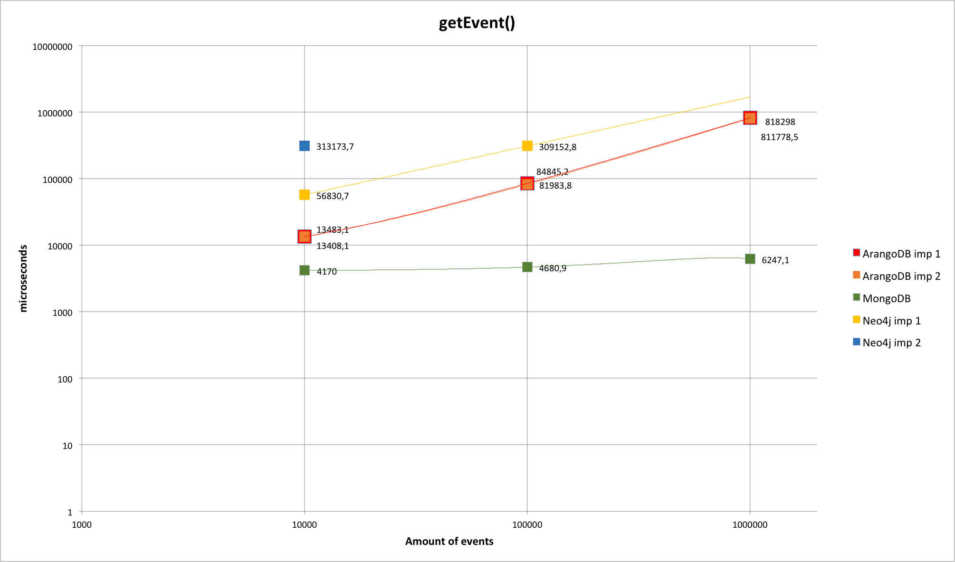

Slide 14
getEvents()
Average execution time
DBMS | 10 000 | 100 000 | 1000 000
MongoDB | 1.13E+05 | 6.76E+05 | 4.17E+06
Neo4j Imp 1 | 2.00E+07 | 1.39E+08 | -
Neo4j Imp 2 | 2.37E+09 | - | -
ArangoDB Imp 1 | 8.49E+04 | 5.96E+05 | 6.28E+06
ArangoDB Imp 2 | 8.38E+04 | 5.64E+05 | 6.35E+06

Slide 15
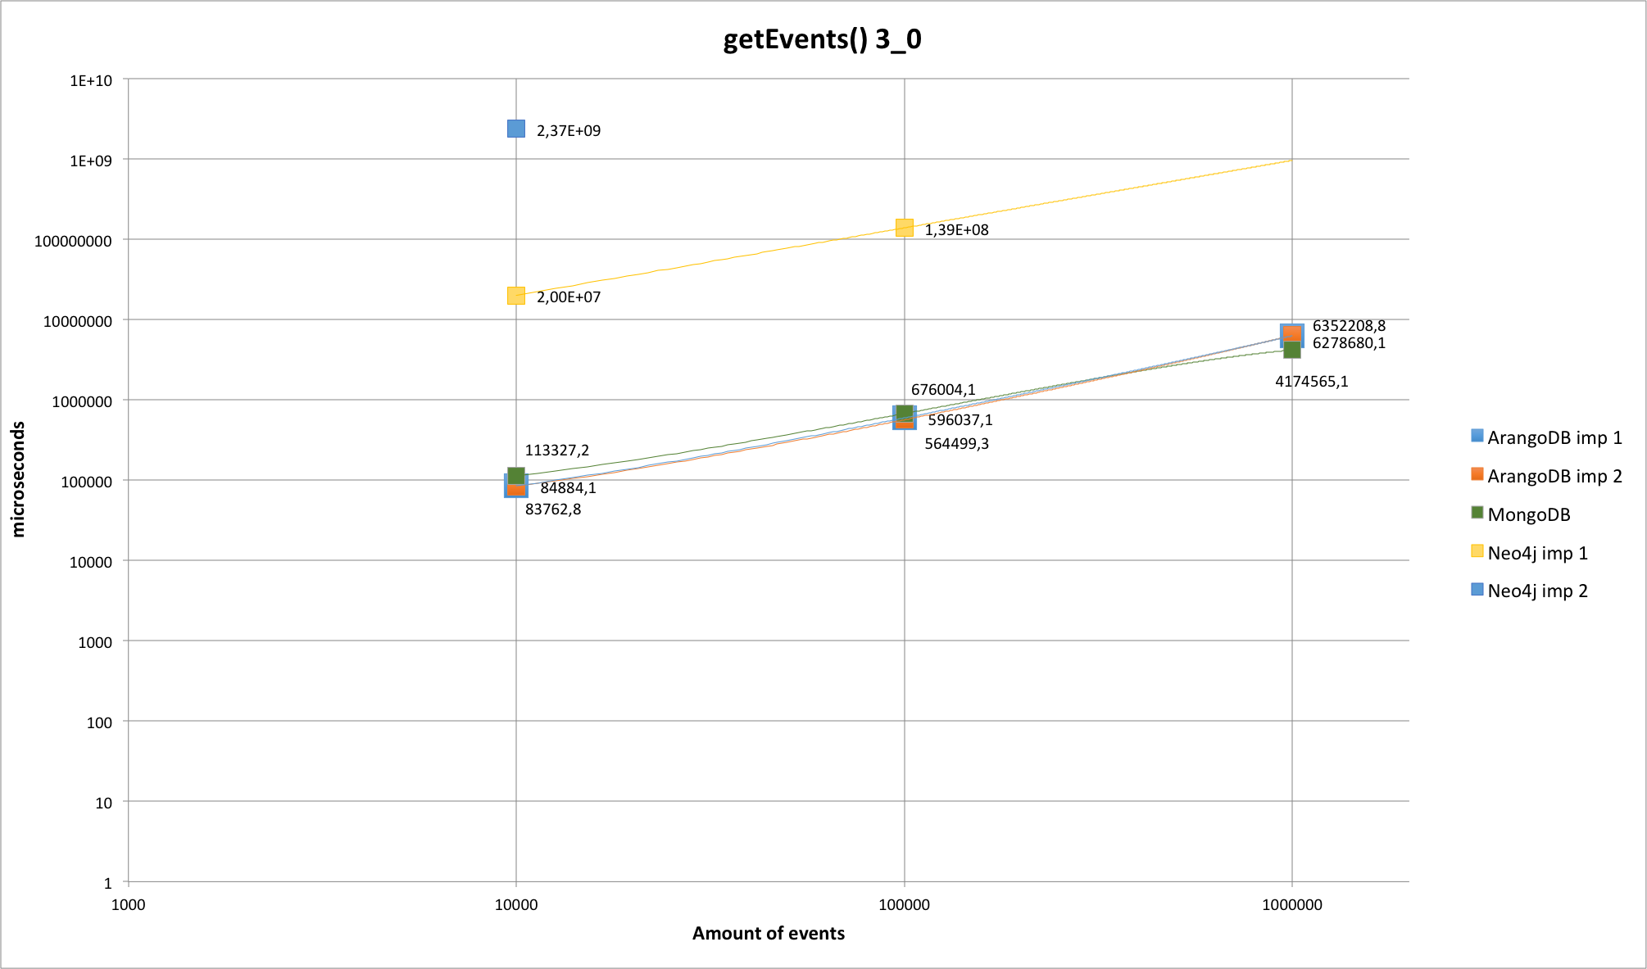


Slide 16
getUpstreamEvents()
Average execution time
DBMS | 10 000 | 100 000 | 1000 000
MongoDB | 4.73E+08 | 4.30E+09 | 4.17E+10
Neo4j Imp 1 | 7.47E+06 | 1.44E+07 | -
Neo4j Imp 2 | - | - | -
ArangoDB Imp 1 | 1.21E+09 | 1.19E+10 | -
ArangoDB Imp 2 | 1.37E+07 | 1.48E+07 | 1.65E+07

Slide 17
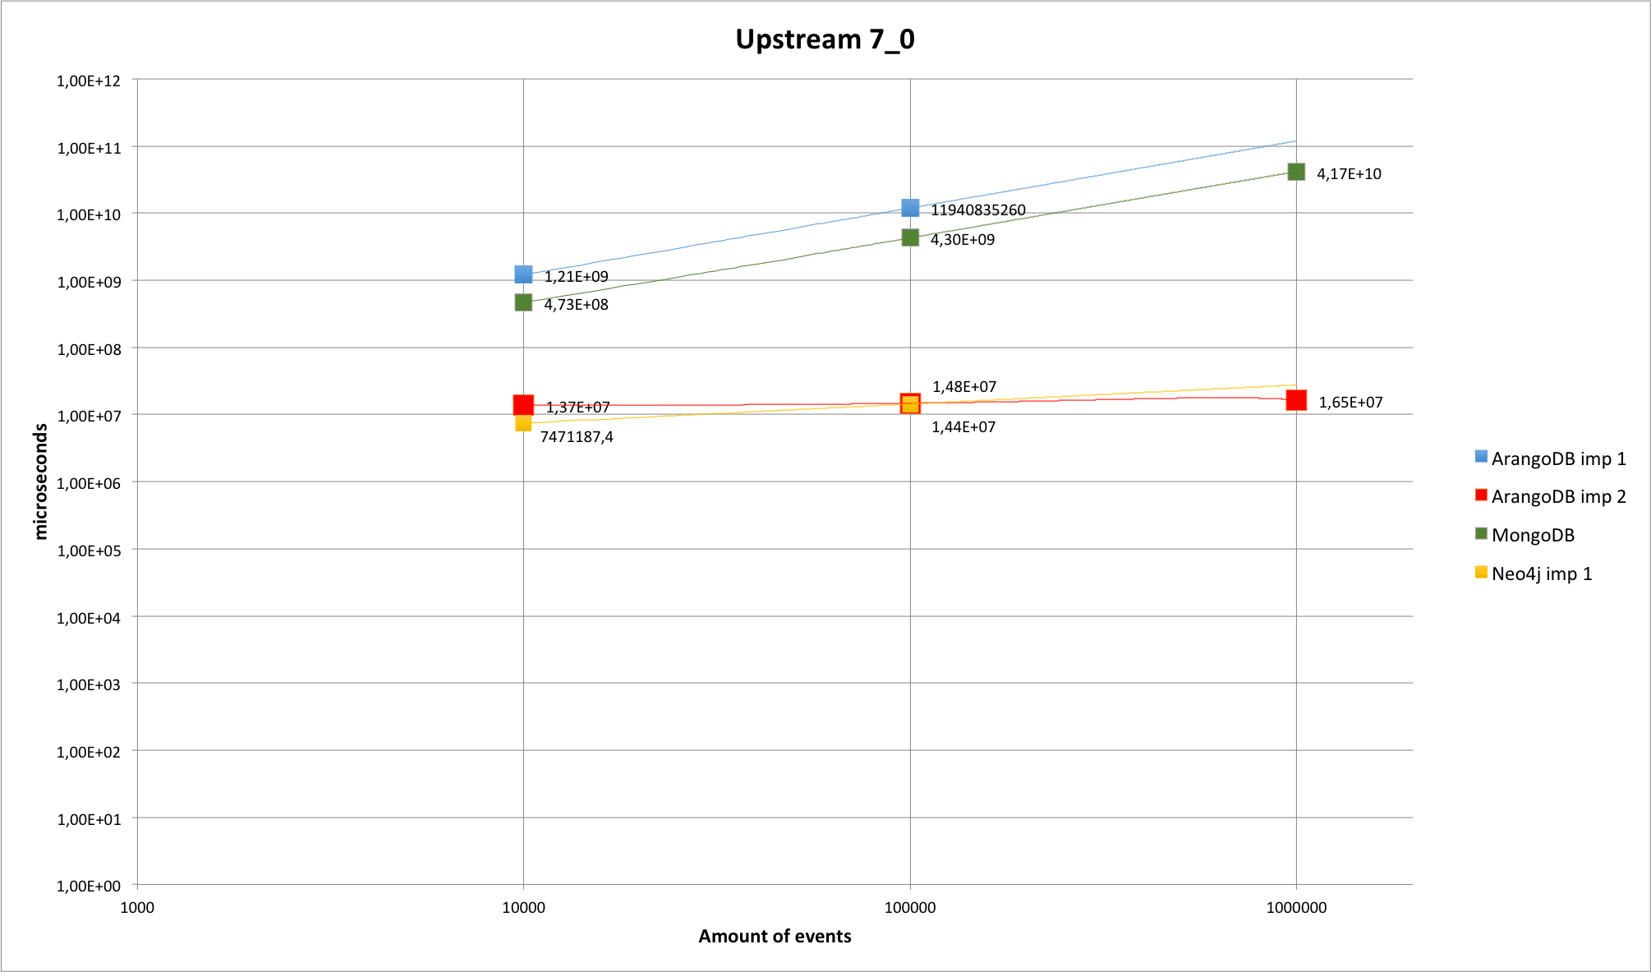

Slide 18
getDownstreamEvents()
Average execution time
DBMS | 10 000 | 100 000 | 1000 000
MongoDB | 8.45E+08 | 8.30E+09 | 8.24E+10
Neo4j Imp 1 | 1.03E+07 | 5.64E+07 | -
Neo4j Imp 2 | - | - | -
ArangoDB Imp 1 | 2.96E+08 | 3.18E+09 | -
ArangoDB Imp 2 | 1.68E+06 | 1.92E+06 | 4.66E+06

Slide 19
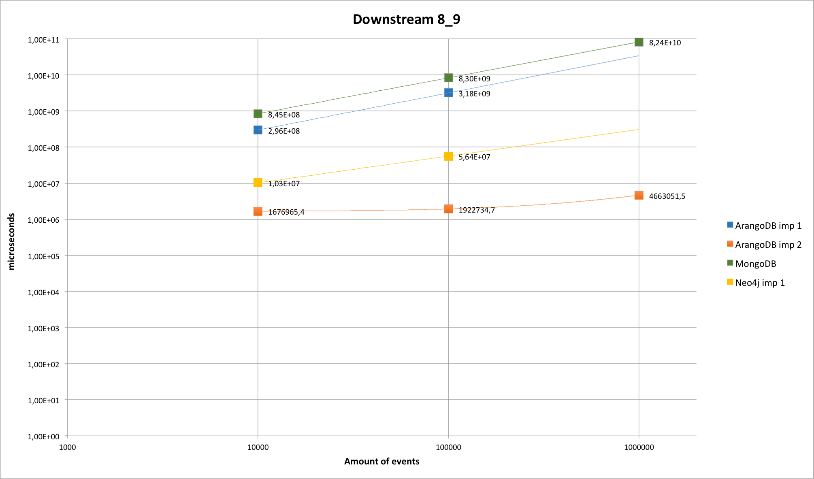

Slide 20
Conclusions And Summary
MongoDB is not optimal for this kind of problems
DBMS that supports graph model would make performance better
Multi-model DBMSs are an option
ArangoDB could be a solution, but problem with getting one event needs to be solved (maybe indexing)
https://github.com/eiffel-community/eiffel-persistence-technology-evaluation

Slide 21
Future investigations
Indexing
Other graph and multi-model DBMS
Cluster

Slide 22
Q&A

